Slide 1

Workshop
Practical Spec-Driven Development With Windsurf and GitHub Spec Kit.

Slide 2
01
02
03
04
05
06
07
08
Environment Check
Windsurf Orientation
Prompt Warm-up
Workflows & Skills
Spec-Driven Development
GitHub Spec Kit
Guided SDD Feature Implementation
Solo SDD Feature Implementation
Pag. 3
Pag. 4
Pag. 5
Pag. 6
Pag. 7
Pag. 8
Pag. 9
Pag. 10

Slide 3
Environment Check
Windsurf license assigned
Installed Windsurf IDE locally
Logged in with Cognition Platform (Enterprise) account
NodeJS and NPM installed
"npm run dev" and "npm run test:e2e" are not missing dependencies

Slide 4
Windsurf Orientation
Open project
Open terminal
Windsurf settings
Disable Auto Execution, Auto Web Requests, Auto-Continue
Open Cascade
Choose a mode
Choose a model

Slide 5
Prompt Warm-up
01 /
Ask Mode
Two prompts that analyze the project.
02 /
Code Mode
Fix failing tests.
03 /
Plan Mode
Replace the bar chart with donut pie chart.

Slide 6
Skills
Workflows
Create a workflow
.windsurf/workflows/workshop.env.check.md
Execute the workflow
/workshop.env.check
Use workflow for
explicit, repeatable runbooks you trigger yourself.
Create a skill
.windsurf/skills/workshop.validator/SKILL.md
Execute the skill
use a prompt like “Validate the workshop solution”
Use skill for
richer reusable capabilities that Cascade can choose automatically, especially when the task needs supporting files such as scripts, templates, examples, or checklists.

Slide 7
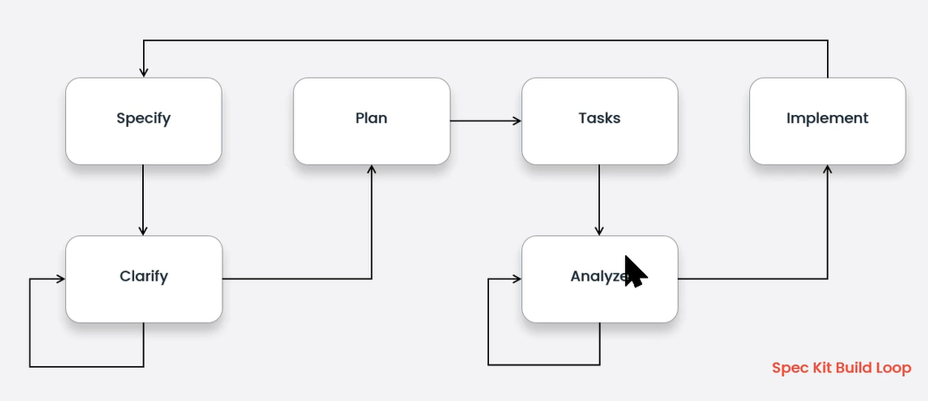
Spec-Driven Development
SDD > Vibe Coding
The goal is more specs less vibes.
Vibe Coding
for experiments, prototypes, or quick throwaway ideas.
SDD
for real codebase that requires more controlled process.
Specification as the main source of truth
Spec-Driven Development means using the specification as the main source of truth, not the code.

Slide 8
GitHub Spec Kit
Installation
uvx --from git+https://github.com/github/spec-kit.git specify init --here
.specify folder
all the Spec Kit related configuration and artefacts are located here (scripts, templates, memories)
.windsurf folder
all the windsurf configuration and artefacts are located here (workflows, skills, rules)

Slide 9
Guided SDD Feature Implementation
Required for the normal workflow
1. /speckit.constitution - Establish project principles (executed only once when the project is established)
2. /speckit.specify - Create baseline specification
3. /speckit.plan - Create implementation plan
4. /speckit.tasks - Generate actionable tasks
5. /speckit.implement - Execute implementation
Optional but often useful
1. /speckit.clarify - Ask structured questions to de-risk ambiguous areas before planning (run before /speckit.plan if used)
2. /speckit.analyze - Cross-artifact consistency & alignment report (after /speckit.tasks, before /speckit.implement)
3. /speckit.checklist - Generate quality checklists to validate requirements completeness, clarity, and consistency (after /speckit.plan)
Key principles
- Be explicit about what you're building and why
- Don't focus on tech stack during specification phase
- Iterate and refine your specifications before implementation
- Validate the plan before coding begins
- Let the coding agent handle the implementation details

Slide 10
Solo SDD Feature Implementation
Small feature
Implement some small feature that will need 3-4 working days to be implemented manually.
Ideas
1. Click dashboard category to filter Expenses page.
2. Dashboard chart type toggle.
3. Bulk select and delete expenses.
4. Category rename.
/speckit.constitution
Do not use /speckit.constitution, it was already executed in the previous exercise.

Slide 11
Q&A

Slide 12
Thank you!

